Slide 1
APA 7th Edition Seminar
FHSS Writing Lab

Slide 2
Disclaimer – APA Manual vs. Professors' Instructions
Although the American Psychological Association (APA) has specific style requirements, professors can make exceptions when desired. When contradictions exist between the professor's assignment description and the APA style manual, always follow the professor's instructions.

Slide 3

General APA Guidelines
Title Page
Introduction
Headings
In-text citations
References

Slide 4
General Guidelines
One-inch margins for entire page
12-pt. Times New Roman, 11-pt. Calibri, Arial, and Georgia, or 10-pt. Lucida Sans Unicode and (Computer Modern)
Double Spaced
Normally write out numbers below 10 and when beginning a sentence
Be aware of exceptions (p. 178)
Introduce all acronyms before using them
Example: The American Psychological Association (APA)

Slide 5
Student Title Page
Include page number, right justified
Have title (up to 12 words) on one to two lines, bolded, and ⅓ of the way down on the page
Space in between title and the rest of the information
Name
Affiliation (university, department, etc.)
Course
Instructor
Due Date

Slide 6
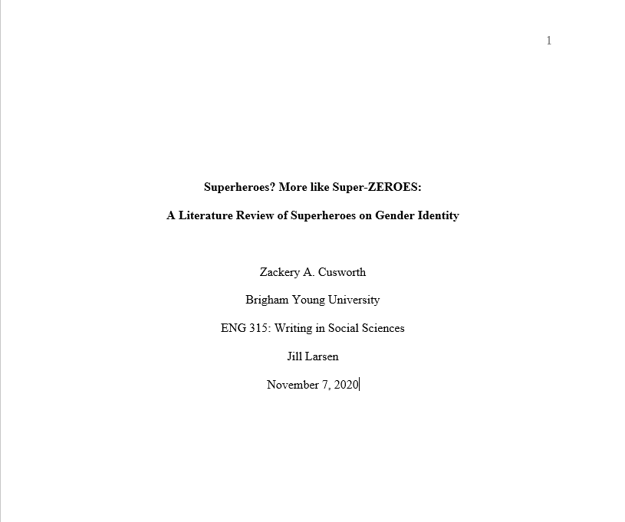
(1) Page Number
(2) Title
(3) Author(s)
(4) Affiliation
(5) Course
(6) Professor
(7) Due Date

Slide 7
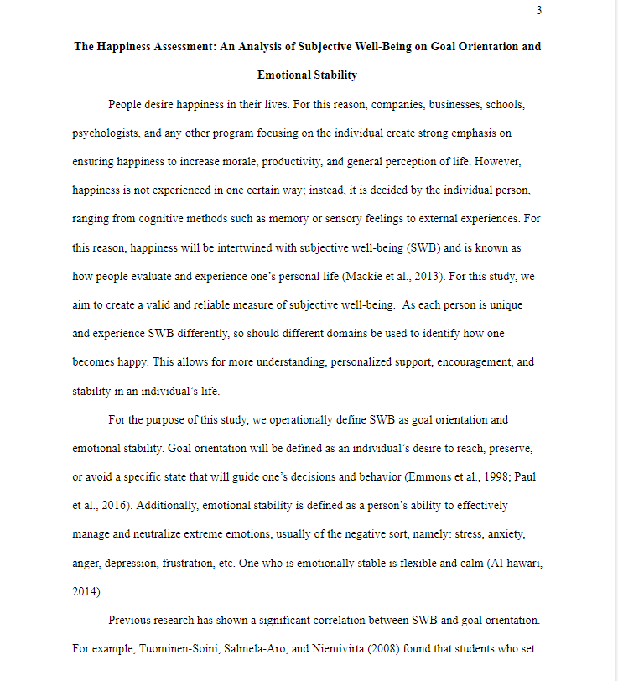
Introduction
Title, bolded
There is no heading titled “Introduction.” Your introduction header is the title of your paper
The thesis typically ends the introduction
After the end of the introduction, begin with a first level heading

Slide 8
Headings
Level | Format
1 | Center, Bold, Title Case Heading Text begins as a new paragraph.
2 | Flush Left, Bold, Title Case Heading Text begins as new paragraph.
3 | Flush Left, Bold Italic, Title Case Heading Text begins as a new paragraph.
4 | Indented, Bold, Title Case Heading, Ending With a Period. Text begins on the same line and continues as a regular paragraph.
5 | Indented, Bold Italic, Title Case Heading, Ending With a Period. Text begins on the same line and continues as a regular paragraph.

Slide 9
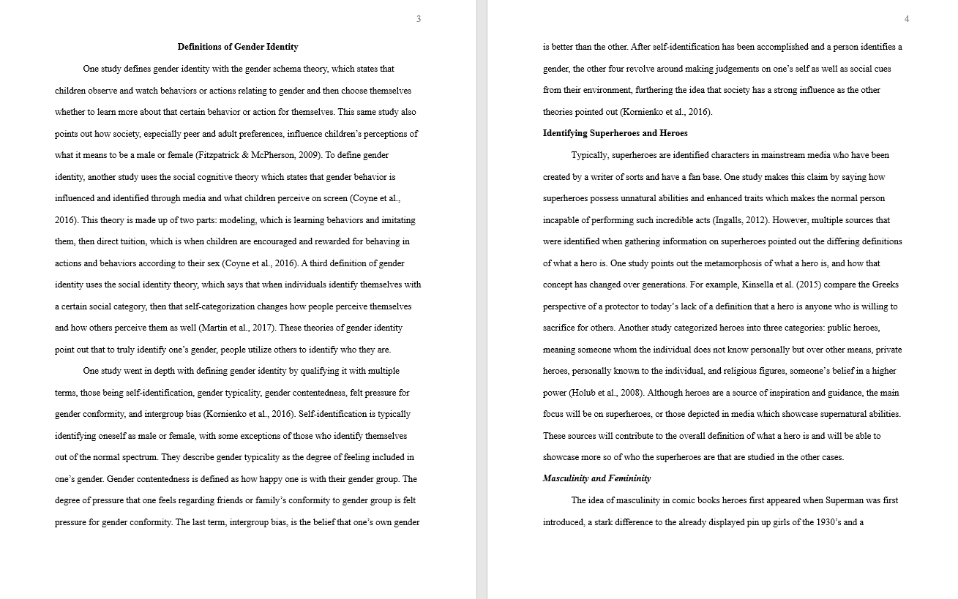
1st Level Heading
2nd Level Heading
3rd Level Heading

Slide 10
Why Cite?
Self-Plagiarism
Representing your own previous work as current and new
Plagiarism
Representing someone else’s work as your own

Slide 11
In-Text Citations
Can be introduced in the sentence or at the end in parenthesis
Includes authors, date, and page number (if direct quote)
The year always follows the author, page number follows the quote

Slide 12
In-Text Citations Examples
It is often found that when teaching children about nutrition, parents should avoid media ideals of appearance (Bauer & Woods, 2019).
Or
Bauer and Woods (2019) found that parents should avoid discussing media ideals of appearance when teaching their children about nutrition.
Teaching children about proper nutrition “affects children’s eating habits and their attitudes towards wellness” (Bauer & Woods, 2019, p. 17).
If multiple pages: pp. 1-6
If no page numbers, use paragraph numbers: para. 4

Slide 13
Additional Rules for In-Text Citations
Use an ampersand (&) if the list of authors appears in parentheses and use the word “and” if authors are listed in the sentence
Period comes after the parentheses to end the sentence
To create a set of cited works within a single set of parenthesis, list the sources in alphabetical order and separate them using semicolons
Avoid overcitation - Do not cite the same reference after every sentence if the information and author has not changed
When repeating the author within the text in this situation, no year is needed

Slide 14
In-Text Citations
Author Type | Parenthetical Citation | In-text Citation
One Author | (Cusworth, 2019) | Cusworth (2019)
Two Authors | (Cusworth & Stout, 2019) | Cusworth and Stout (2019)
Three or more authors | (Cusworth et al., 2019) | Cusworth et al. (2019)
Group author (first citation) | (American Psychological Association [APA], 2019) | American Psychological Association (APA, 2019)
Group author (subsequent citations) | (APA, 2019) | APA (2019)
Group Author without abbreviation | (Stanford University, 2019) | Stanford University (2019)

Slide 15
Practice
Cass & Hilton (2019) described the negative outcomes of populations with declining voter participation.
Cass and Hilton showcases the need for increased voter participation in first world countries (2019).
Cass and Hilton (2019) studied the effects of polarization of parties on newly registered voters.
The year follows the authors and uses the word “and”

Slide 16
Practice
Reese, Nuccitelli, and Day (2020) looked at the effects of art education in regards to individual ability.
Reese et al. (2020) demonstrated the importance of increased focus on personal development.
Although difficult to replicate, Reese et al. provided sufficient data in understanding personal drive and positivity (2020).
Always use et al. with 3+ authors and the year follows the authors

Slide 17
Practice
Judge and Larson (2020; 2019) studied the effects of individual education plans (IEP) on political ideology.
Multiple studies have showcased the importance of independence in middle school aged students (Judge, 2020; Larson, 2019).
Both studies are useful in determining the effects of parental influence in political stances (Judge, 2020, Larson, 2019).
Separate authors with a semicolon

Slide 18
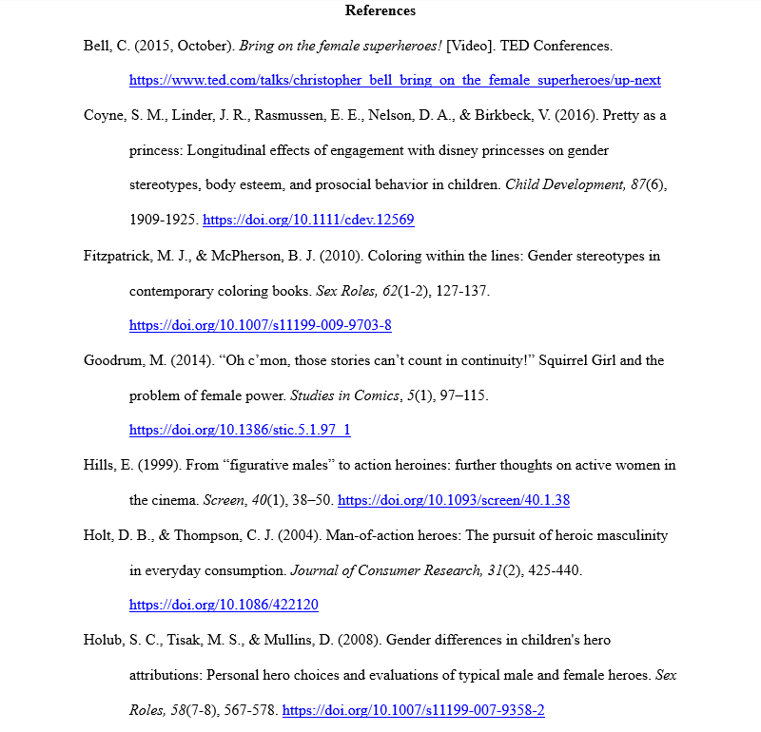
References
(1)
(2)
(1) “References” centered and bolded
(2) Hanging indent for all sources
(3) Listed alphabetically
(4) Keep hyperlink on DOI/URL
(5) 21+ authors rule
(3)
(4)

Slide 19
Journal Article with a DOI/URL
Last name, First and Middle Initials. (year). Title of article.
Journal Name, volume(issue), page numbers.
https://doi.org/00000000000
(if no DOI then https://www.website.org/blahblah)
Cusworth, Z. A., & Stout, A. E. (2019). Disneyland: The
best amusement park. Amusement General, 5(12),
33-54. https://doi.org/000000000000

Slide 20
Book Reference
Last name, First and Middle Initials. (year). Title of book.
Publisher name. (if online, add DOI/URL)
Cusworth, Z. A. (2018). How to achieve true happiness: A
Disneyland perspective. Lopez Publishers.
https://doi.org/000000000000

Slide 21
